Slide 1

Group Project ~ OMIS 652
Anushka Verma (Z1911937)
Uzma Khan (Z1977614)
Tejaswini Mode (Z1966081)
Mohammad Sohaib Uddin (Z1964113)

Slide 2
Table of contents
01
02
03
04
Introduction
ERD
Normalization
Queries
05
Conclusion

Slide 3
01
Introduction:
FitFreak is a premier fitness company with multiple locations, committed to helping people of all fitness levels achieve their health and wellness goals. Whether you're a seasoned athlete or a fitness newbie, FitFreak has everything you need to get fit and stay fit.

Slide 4
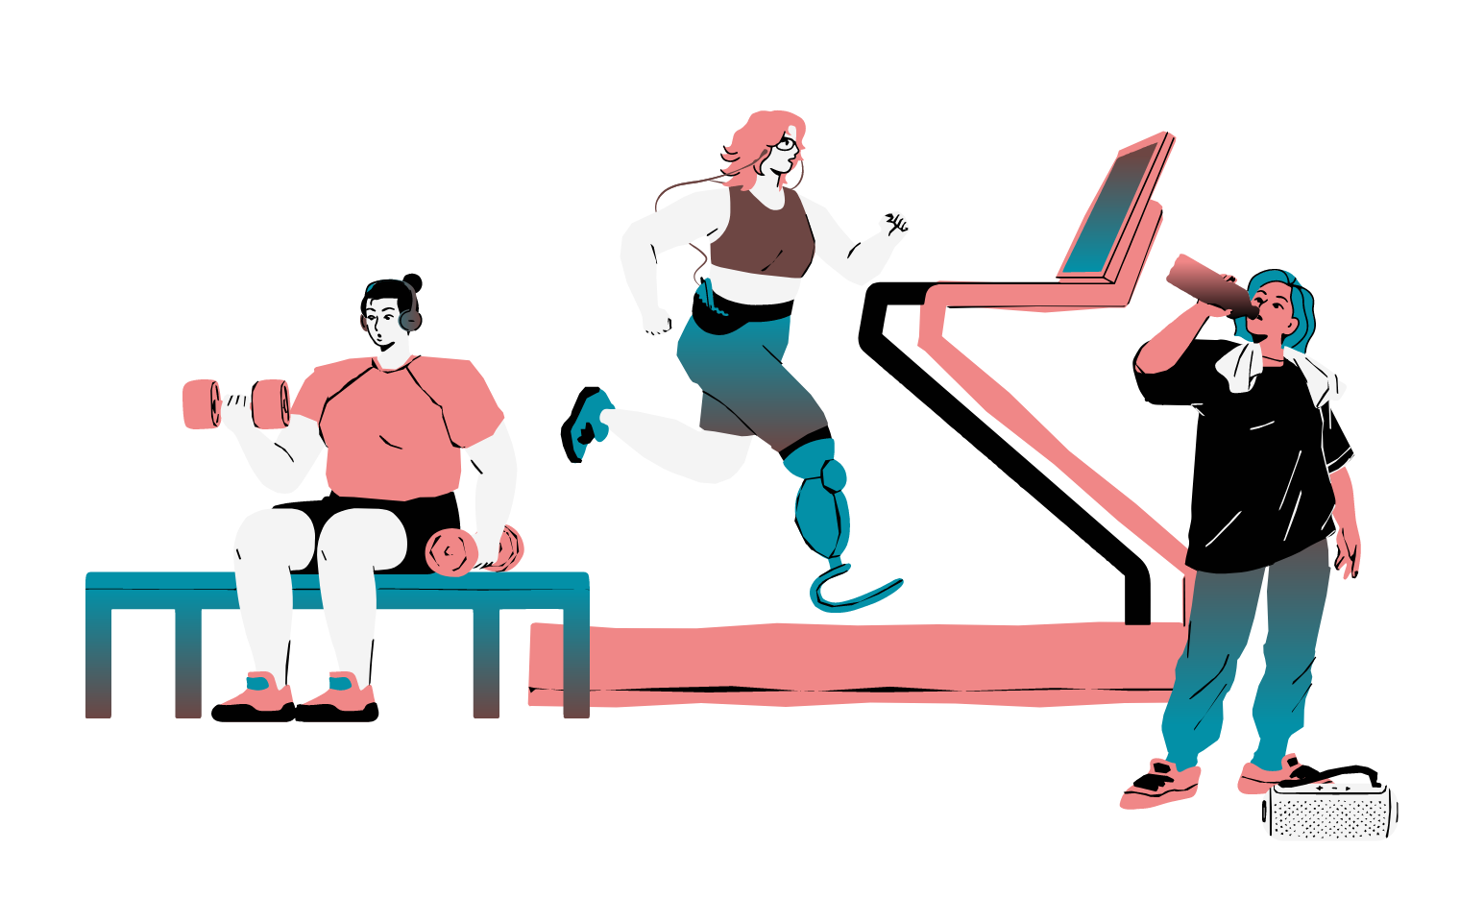
Entities:
Customer
Membership Registration
Membership Type
Payment
Class
Instructor
Employee
Order Item
Product
Equipment
Class Enrollment
Gym
Zipcode
Payroll
Incentive
Order Header
Coupon Condition
Customer Coupon
Feedback

Slide 5
02
ERD Time!

Slide 6
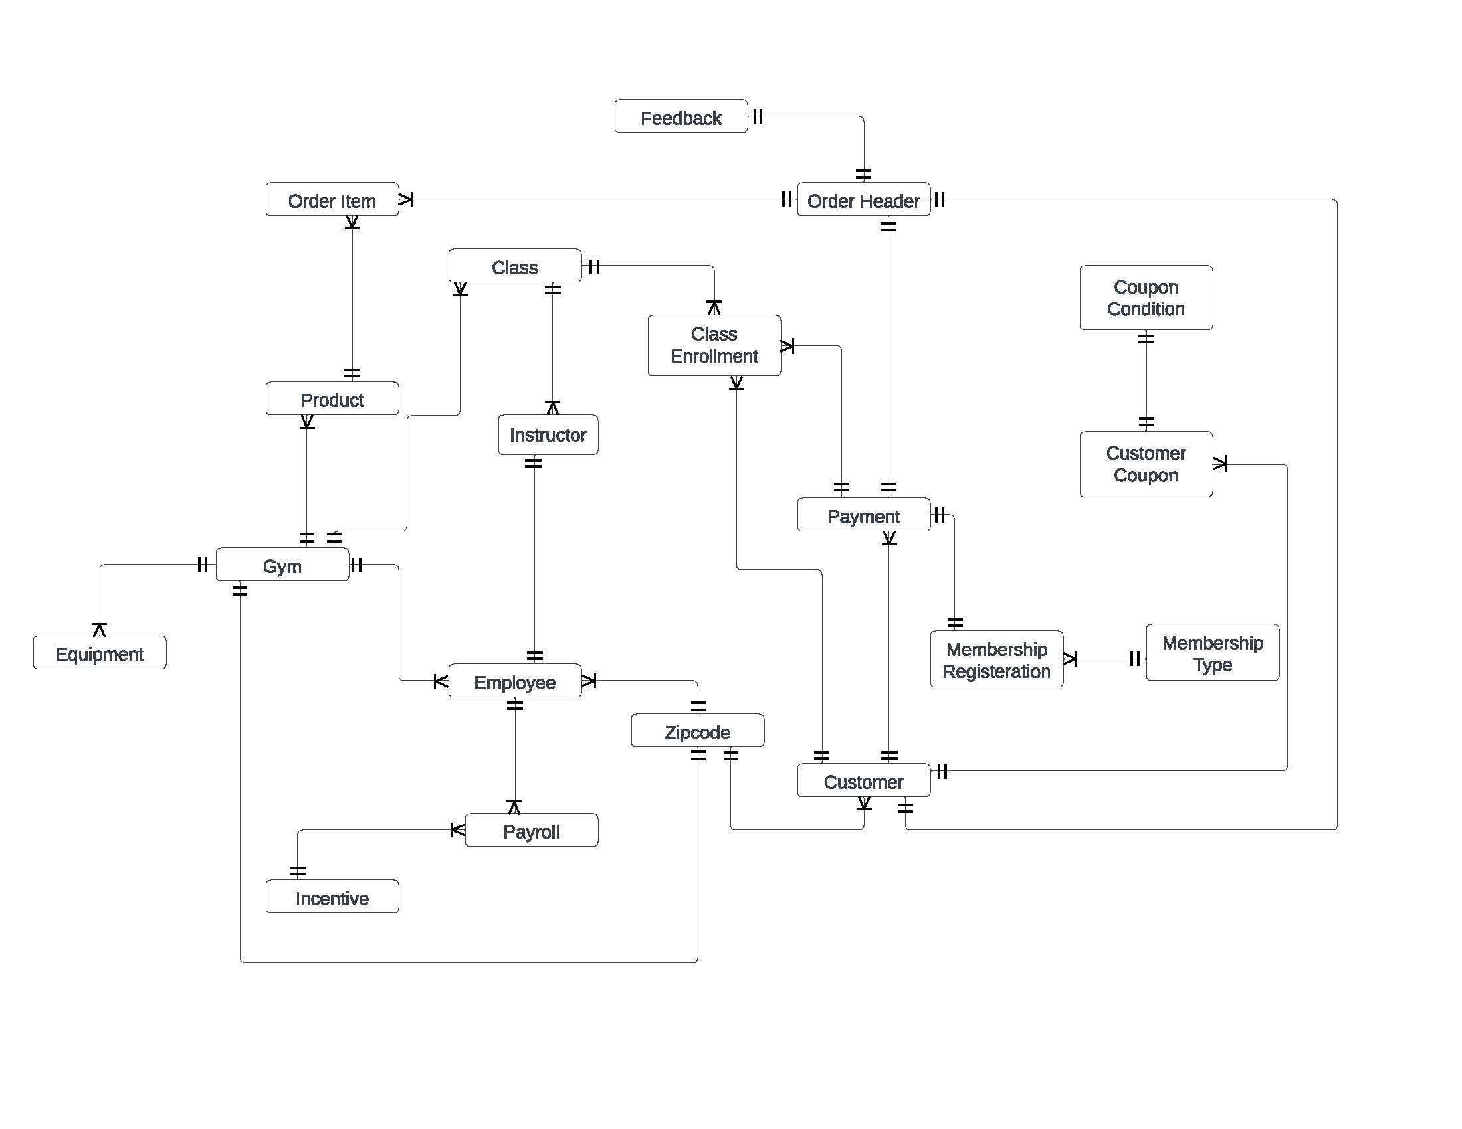

Slide 7
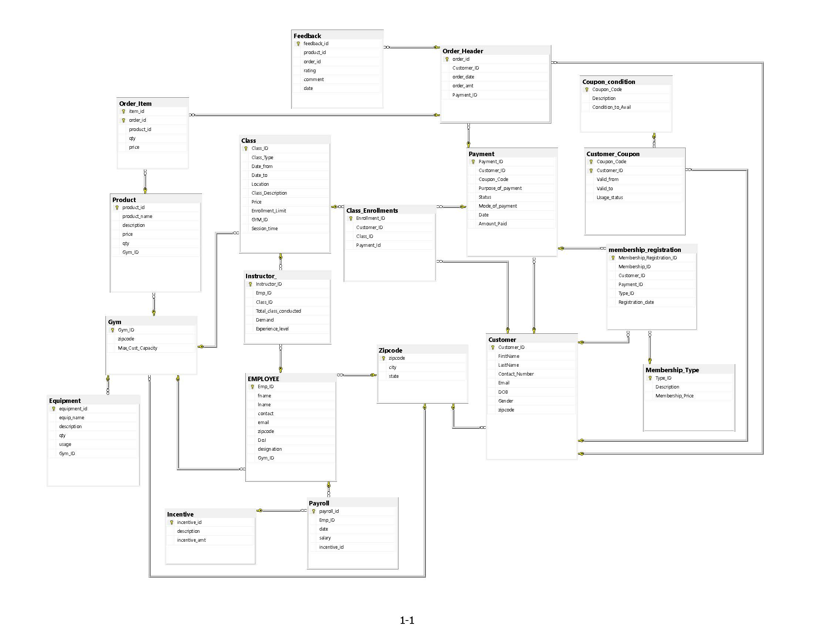

Slide 8

Assumptions ~
A customer can switch from solo membership to family membership and vice versa by making a new payment.
Partial payment cannot be done
A coupon code can be generated for every member customer in family membership.

Slide 9
03
Normalization Time!

Slide 10
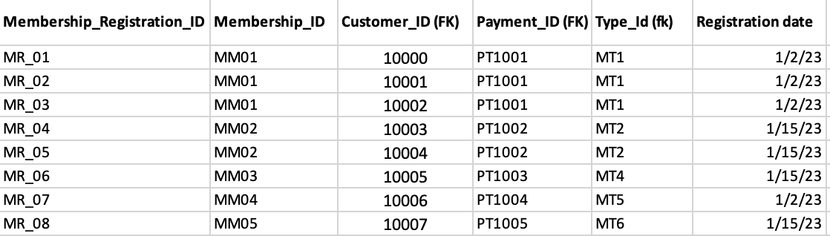
Normalization ~
Membership_Registration Table:

Slide 11
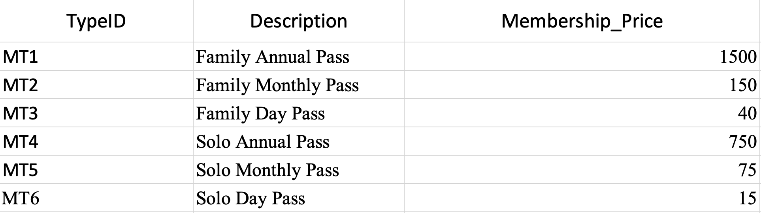
Normalization ~
Membership_Type Table:

Slide 12

04
Queries Time!

Slide 13
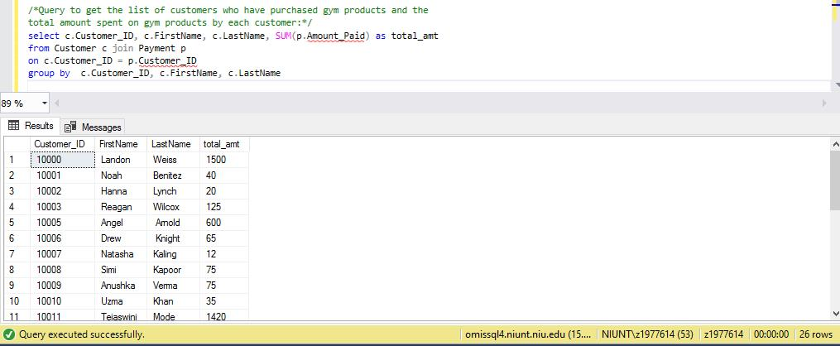
Find a query to get the list of customers who have purchased gym products and the total amount spent on gym products by each customer

Slide 14
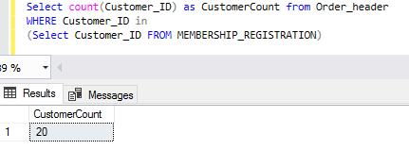
Find a query to find the number of customers who have purchased gym products and have also registered for any gym membership

Slide 15
Conclusion!
05

Slide 16

Conclusion ~
FitFreak Gym's database design provides an efficient solution to manage the gym's operations, customers, and products. The design covers all the necessary aspects, from memberships and classes to discounts and equipment inventory.

Slide 17
Thank You!

